Slide 1
UTCN

Slide 2
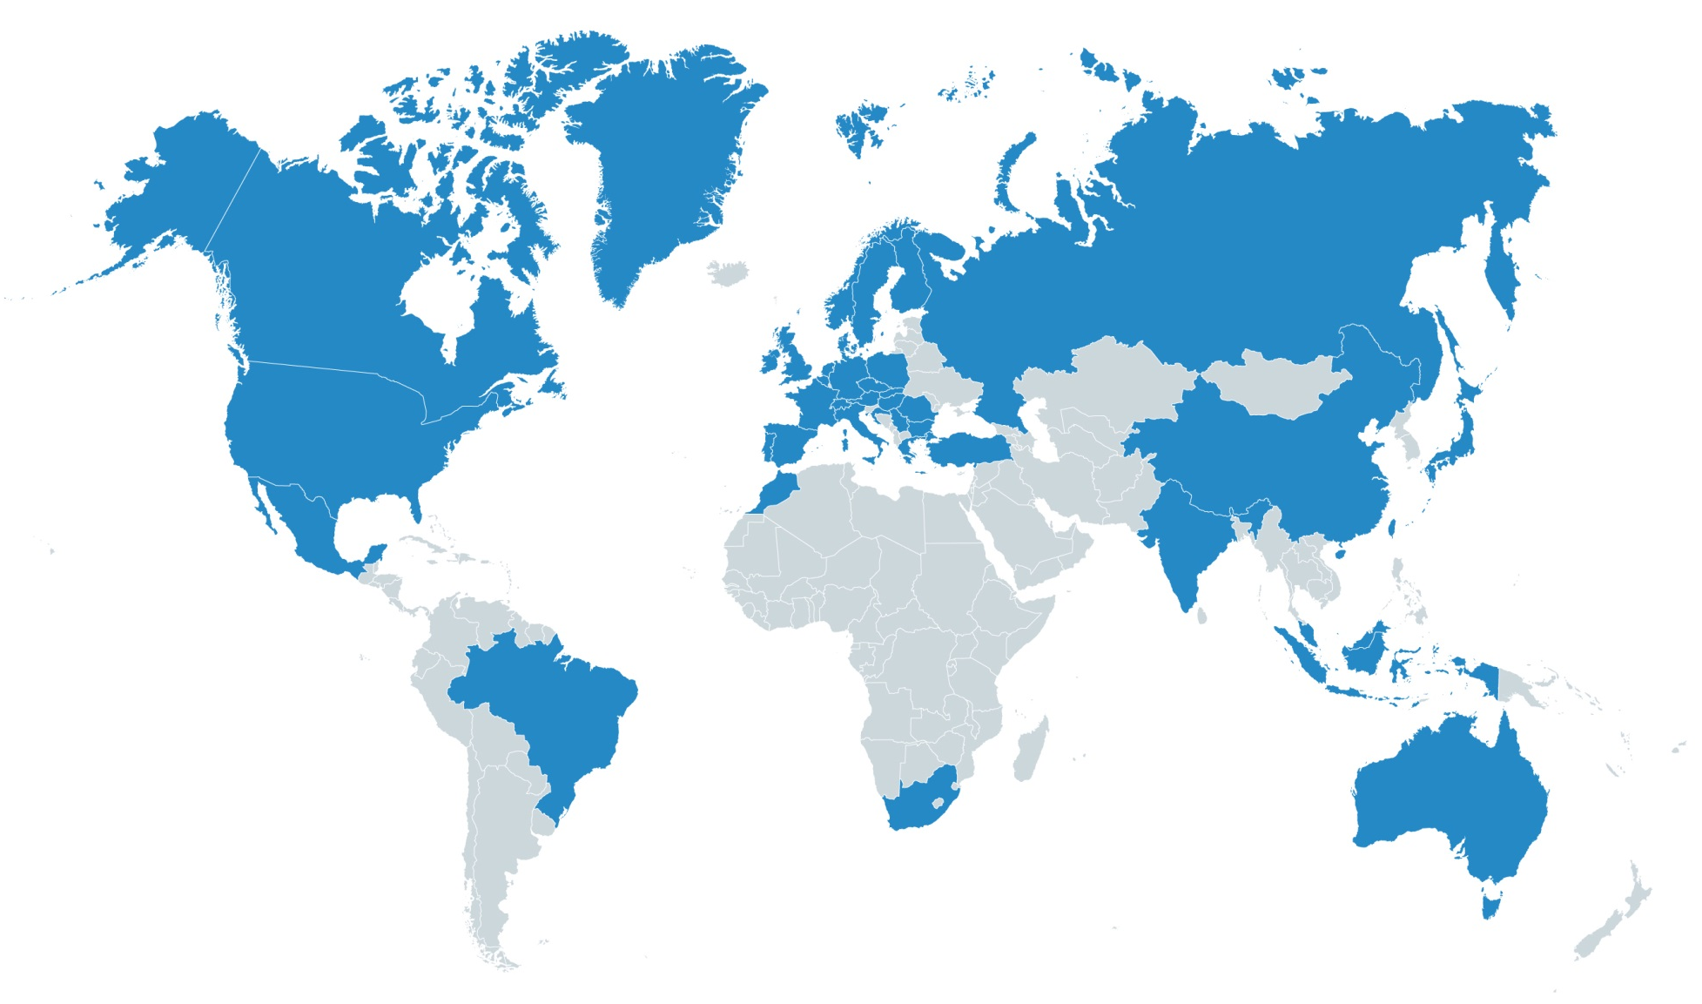



trendence worldwide
School leavers
Graduates
Professionals
over 500.000 participants
over 1.000 universities
worldwide

Slide 3

trendence offers a clear overview of all talented graduates
OUR EUROPEAN EDITIONS
Business
Engineering/IT
Total
trendence Graduate Barometer in 24 countries!
Number of participants
Austria
Belgium
Bulgaria
Czech Republic
Denmark
Finland
France
Germany
Greece
Hungary
Ireland
Italy
Netherlands
Norway
Poland
Portugal
Romania
Russia
Slovakia
Spain
Sweden
Switzerland
Turkey
UK
110.000
120.000
300.000
Number of universities
670
700
930
Fieldphase
Sep 2015 – Feb 2016

Slide 4
Publication Information
Dear readers,
Thank you for your participation in the trendence Graduate Barometer 2016! This report has been specifically compiled for your university and contains data that has not yet been published.
You are welcome to use individual figures from this report for internal and external communication through the university website or newsletter citing trendence Institute as your source in the text.
However, publication of the whole report or parts thereof, e.g. complete tables or images, is not permitted.
You may use the reported data for academic purposes (personal studies, lectures etc.).
Furthermore, you are permitted to publish the report results on restricted access platforms which are university internal, provided that the data cannot be forwarded to third parties through this platform.
Kind regards,
Your trendence team

Slide 5



Contents
  Key groups surveyed
  Sample size and demographic information
  Anticipated degrees and fields of study
  Student experiences
I. Students Surveyed
  External Benchmark: Key Performance Indicators and position in Europe
  Internal Benchmark: Importance vs. satisfaction, recommendations, preferred university for further studies
II. Student Feedback on Universities
  Important factors regarding student selection of employers
  Most popular top employers, expected income and working hours
  Mobility and student opinions
III. Communication
and Career

Slide 7
Contents
  Key groups surveyed
  Sample size and demographic information
  Anticipated degrees and fields of study
  Student experiences
I. Students Surveyed
  External Benchmark: Key Performance Indicators and position in Europe
  Internal Benchmark: Importance vs. satisfaction, recommendations, preferred university for further studies
II. Student Feedback on Universities
  Important factors regarding student selection of employers
  Most popular top employers, expected income and working hours
  Mobility and student opinions
III. Communication
and Career

Slide 11

trendConcept Soft Skills
From the five personality dimensions of the Big-Five Model, four are included in trendConcept Soft Skills.
SOCIAL COMPETENCY
RELIABILITY
ACHIEVEMENT AND ASPIRATION
FLEXIBILITY
ABILITY TO WORK UNDER PRESSURE
I observe the facial expressions and gestures of my conversational partner.
I leave my conversational partner space for argumentation, before I express my opinion.
I stick to predetermined deadlines.
I check my work for accuracy before I hand it in.
I am very annoyed by my own mistakes and try to learn from them.
In my spare time I read professional literature to further educate myself.
After internal corporate restructuring, I am open to new topics and tasks.
If I notice that I get stuck, I change my strategy.
I remain friendly in the face of fierce criticism and do not feel personally attacked.
I keep to a predetermined deadline, although this means an increased workload.
The four dimensions Authenticity, Social Skilfulness, Networking Skills and interpersonal influence of political skills from the Political Skills Model were summarised as social competencies and taken on by trendConcept Soft Skills.
The measurement of Soft Skills by trendence is based on the long-term practical experience with the Big-Five-Model by Costa & McCrae from personality psychology as well as the Political Skills Model of Ferris et. al.
SCALE
not correct at all
completely correct
APPROACH
Definition of success factors relevant for professional success on the basis of both theoretical models as well as trendence‘s practical experience
Using the "Act-Frequency Approach" to identify the statements to be evaluated by the students (Acts)
Generation and selection of the Acts with the help of two pre-tests (Prototypes)
Students who agree fully or preferably to both statements of one trait, are attributed to this respective trait.

Slide 14
Contents
  Key groups surveyed
  Sample size and demographic information
  Anticipated degrees and fields of study
  Students experiences
I. Students Surveyed
  External Benchmark: Key Performance Indicators and position in Europe
  Internal Benchmark: Importance vs. satisfaction, recommendations, preferred university for further studies
II. Student Feedback
on Universities
  Important factors regarding student selection of employers
  Most popular top employers, expected income and working hours
  Mobility and student opinions
III. Communication
and Career

Slide 15


trendConcept University Feedback
How can we make more transparent, what is most important for students in their studies?
Students’ Feedback
We asked students: What is important when we talk about „good“ study conditions, lectures, IT- infrastructure, etc.?
How can they rate universities on these issues?
Results: trendConcept University Feedback
The big picture: Overall satisfaction grade
Detailed analysis: 10 main topics which are represented by 28 issues in order of their importance to students compared with students‘ satisfaction
Recommendation of your university
Your branding tool:
External Benchmark
Position in Europe
KPI – Key Performance Indicators: provides a benchmark regarding all universities represented in your country and in this edition
Internal Benchmark
Importance versus satisfaction
Recommendation of your university
Find out where you stand – Brand your university

Slide 16
trendConcept University Feedback

Slide 18


1.
2.
KPI calculation
The KPI‘s for your university have been individually calculated per topic
The statistical range of the KPI‘s is determined by the two highest and lowest rated universities and not by a numerically in advance defined limit
3.
4.
5.
6.
7.
8.
9.
10.

Slide 25
Contents
  Key groups surveyed
  Sample size and demographic information
  Anticipated degrees and fields of study
  Student experiences
I. Students Surveyed
  External Benchmark: Key Performance Indicators and position in Europe
  Internal Benchmark: Importance vs. satisfaction, recommendations, preferred university for further studies
II. Student Feedback on Universities
  Important factors regarding student selection of employers
  Most popular top employers, expected income and working hours
  Mobility and student opinions
III. Communication
and Career

Slide 37
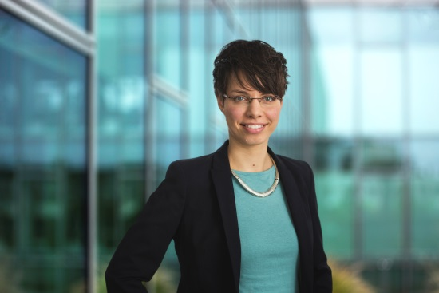




CHRISTINE DIETZSCH
Head of Partner Relations
christine.dietzsch@trendence.com
+49 30 2592988-311
trendence Institut GmbH
Markgrafenstraße 62
10969 Berlin
Germany
www.trendence.com and on

Slide 38

FLORIAN HANEL
Country Manager DACH
florian.hanel@trendence.com
+49 30 2592988-618
trendence Institut GmbH
Markgrafenstraße 62
10969 Berlin
Germany
www.trendence.com and on

